Slide 1


Slide 2
Technical Note 4
Job Design and Work Measurement

Slide 3
OBJECTIVES
Job Design Defined
Job Design Decisions
Trends in Job Design
Work Measurement
Basic Compensation Systems
Financial Incentive Plans
Notes:
2

Slide 4
What is Job Design?
Defined
Job design is the function of specifying the work activities of an individual or group in an organizational setting
The objective of job design is to develop jobs that meet the requirements of the organization and its technology and that satisfy the jobholder’s personal and individual requirements
Notes:
4

Slide 5

Job Design Decisions
Who
What
Where
When
Why
How
Mental and
physical
characteristics
of the
work force
Tasks to be
performed
Geographic
locale of the
organization;
location of
work areas
Time of day;
time of
occurrence in
the work flow
Organizational
rationale for
the job; object-
ives and mot-
ivation of the
worker
Method of
performance
and
motivation
Ultimate
Job
Structure
Notes:
4

Slide 6
Trends in Job Design
Quality control as part of the worker's job
Cross-training workers to perform multi skilled jobs
Employee involvement and team approaches
to designing and organizing work
"Informating" ordinary workers through
e-mail and the Internet
Notes:
4

Slide 7
Trends in Job Design (Continued)
Extensive use of temporary workers
Automation of heavy manual work
Organizational commitment to providing
meaningful and rewarding jobs for all
employees
Notes:
4

Slide 8
Behavioral Considerations in Job Design
Balancing the specialization in a job and its content through enrichment can give us….
Degree of
Specialization
Ultimate Job
Structure
Job Enrichment
(vs. Enlargement)
Notes:
4

Slide 9
Sociotechnical Systems
Focuses on the interaction between technology and the work group by looking at….
Task Variety
Skill Variety
Feedback
Task Identity
Task Autonomy
Process Technology Needs
Worker/Group Needs
Notes:
4

Slide 10
Physical Considerations in Job Design
Work physiology sets work-rest cycles according to the energy expended in various parts of the job. The harder the work, the more the need for rest periods.
Ergonomics is a term used to describe the study of the physical arrangement of the work space together with tools used to perform a task. Fit the work to the body rather than forcing the body to conform to the work.
Notes:
4

Slide 11
Work Methods
A Production
Process
Ultimate Job Design
Ultimate Job Design
Workers Interacting
with Other Workers
Worker at a Fixed
Workplace
Worker Interacting
with Equipment

Slide 12
Work Measurement
Defined
Work measurement is a process of analyzing jobs for the purpose of setting time standards
Why use it?
  Schedule work and allocate capacity
  Motivate and measure work performance
  Evaluate performance
  Provide benchmarks
Notes:
4

Slide 13
Time Study Normal Time Formulas
Normal time(NT)=Observed performance time per unit
x (Performance rating)*
*The Performance Rating is usually expressed in decimal form in these formulas. So a person working 10% faster than normal would have a Performance Rating of 1.10 or 110% of normal time. Working 10% slower, 0.90 or 90% of normal.
NT= Time worked _ x (Performance rating)* Number of units produced
Notes:
17

Slide 14
Time Study Standard Time Formulas
Standard time = Normal time + (Allowances x Normal times)
Standard time = NT(1 + Allowances)
Standard time = NT .
  1 - Allowances
Notes:
17

Slide 15
Time Study Example Problem
You want to determine the standard time for a job. The employee selected for the time study has produced 20 units of product in an 8 hour day. Your observations made the employee nervous and you estimate that the employee worked about 10 percent faster than what is a normal pace for the job. Allowances for the job represent 25 percent of the normal time.
Question: What are the normal and standard times for this job?
Notes:
17

Slide 16
Time Study Example Solution
Normal time = Time worked x (Performance rating)
Number of units produced
= (480 minutes/20) x (1.10)
= 26.4 minutes
Standard time = NT .
  1 – Allowances
= (26.4)/(1-0.25)
= 35.2 minutes
Notes:
17

Slide 17
Work Sampling
Use inference to make statements about work activity based on a sample of the activity
Ratio Delay
  Activity time percentage for workers or equipment
Performance Measurement
  Relates work time to output (performance index)
Time Standards
  Standard task times
Notes:
15

Slide 18
Advantage of Work Sampling over Time Study
Several work sampling studies may be conducted simultaneously by one observer
The observer need not be a trained analyst unless the purpose of the study is to determine a time standard
No timing devices are required
Work of a long cycle time may be studied with fewer observer hours
Notes:
16

Slide 19
Advantage of Work Sampling over Time Study (Continued)
The duration of the study is longer, which minimizes effects of short-period variations
The study may be temporarily delayed at any time with little effect
Because work sampling needs only instantaneous observations (made over a longer period), the operator has less chance to influence the findings by changing work method
Notes:
17

Slide 20
Basic Compensation Systems
Hourly Pay
Straight Salary
Piece Rate
Commissions
Notes:
18

Slide 21
Financial Incentive Plans
Individual and Small-Group Plans
  Output measures
  Quality measures
  Pay for knowledge
Organization-wide Plans
  Profit-sharing
  Gain-sharing
    Bonus based on controllable costs or units of output
    Involve participative management
Notes:
19

Slide 22
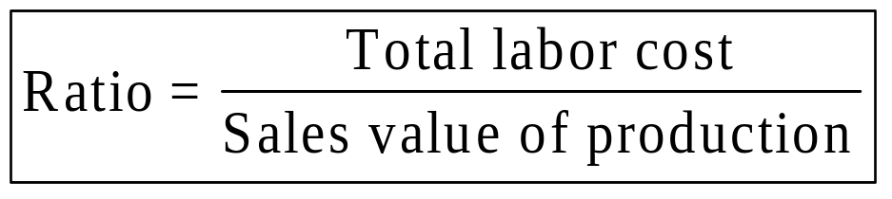
Scanlon Plan
Basic Elements
The ratio
  Standard for judging business performance
The bonus
  Depends on reduction in costs below the preset ratio
The production committee
The screening committee
Notes:
20

Slide 23
Pay-for-Performance
Paying employees based on their performance works--improvements in productivity and quality
Pay-for-performance will become increasingly common components of performance management strategies and systems
Notes:
21

Slide 24
End of Technical Note 4

